Slide 2
How Halo, Dynamics 365, and Mesh scale to millions with Orleans and you can too!
Brady Gaster, Program Manager
Reuben Bond, Software Engineer
Benjamin Petit, Software Engineer

Slide 3
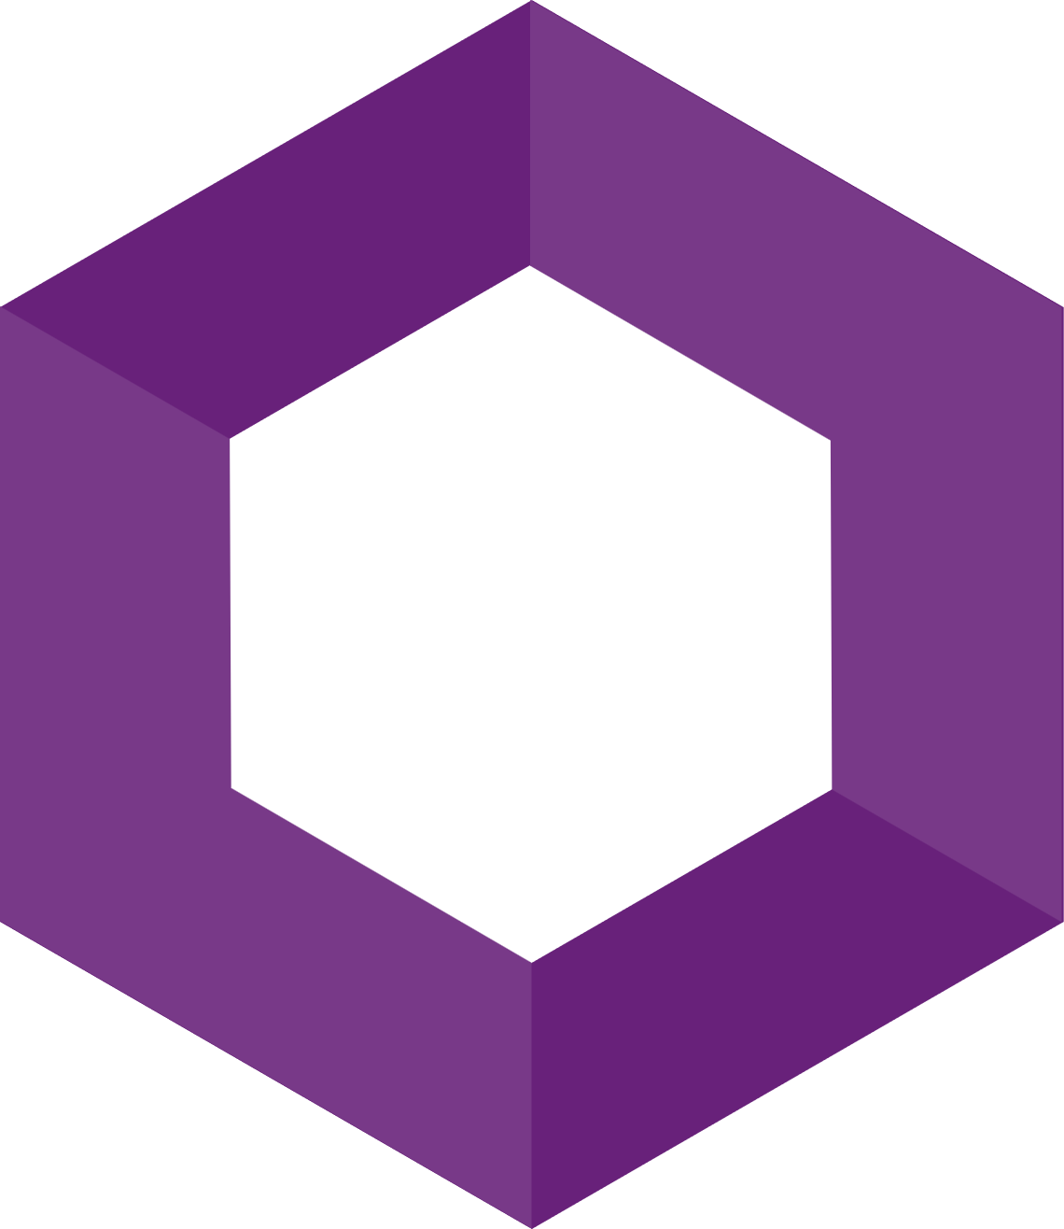
Halo
Orleans

Slide 4
Halo
Azure IoT Digital Twins
Microsoft
Mesh
Microsoft Teams
Azure Active Directory
Xbox Publishing
Dynamics 365 Fraud Protection
Orleans
Azure PlayFab
Azure
Machine Learning
Gears
Skype
Azure Batch
Azure Orbital
Azure Quantum

Slide 5
Orleans add distributed processing to ASP.NET Core
ASP.NET Core Host
MVC Controllers
Minimal Endpoints
SignalR Hubs
Worker Services

Slide 6
Orleans add distributed processing to ASP.NET Core
ASP.NET Core Host
ASP.NET Core Host
ASP.NET Core Host
ASP.NET Core Host
MVC Controllers
MVC Controllers
MVC Controllers
MVC Controllers
Minimal Endpoints
Minimal Endpoints
Minimal Endpoints
Minimal Endpoints
SignalR Hubs
SignalR Hubs
SignalR Hubs
SignalR Hubs
Worker Services
Worker Services
Worker Services
Worker Services

Slide 7
Orleans add distributed processing to ASP.NET Core
ASP.NET Core Host
ASP.NET Core Host
ASP.NET Core Host
ASP.NET Core Host
MVC Controllers
MVC Controllers
MVC Controllers
MVC Controllers
Minimal Endpoints
Minimal Endpoints
Minimal Endpoints
Minimal Endpoints
SignalR Hubs
SignalR Hubs
SignalR Hubs
SignalR Hubs
Worker Services
Worker Services
Worker Services
Worker Services
Grains

Slide 8
Orleans add distributed processing to ASP.NET Core
ASP.NET Core Host
ASP.NET Core Host
ASP.NET Core Host
ASP.NET Core Host
MVC Controllers
MVC Controllers
MVC Controllers
MVC Controllers
Minimal Endpoints
Minimal Endpoints
Minimal Endpoints
Minimal Endpoints
SignalR Hubs
SignalR Hubs
SignalR Hubs
SignalR Hubs
Worker Services
Worker Services
Worker Services
Worker Services
Grains

Slide 9
Orleans at-a-glance
Persistence
Plugins for Azure Storage, Cosmos DB, SQL, DynamoDB, Redis, MongoDB
Distributed ACID transactions
Read/write state in multiple grains transactionally
Virtual streams
Decouple producers & consumers. Backed by Azure Event Hubs, Amazon SQS, GCP, in-memory
Timers & reminders
Ephemeral timers, persistent reminders for scheduling future event
Observers
Push notifications back to clients or other grains
Transport layer security
Mutual TLS between clients and the cluster as well as nodes within the cluster
Deployment freedom
Azure, AWS, GCP, on-prem, Kubernetes, Service Fabric, Windows, Linux, macOS
Custom placement & directory
Customize how the runtime decides where new grains are instantiated
Call filters
Wrap incoming & outgoing requests & responses for logging, tracing, error handling
Notes:
~3 mins
Alright, last slide about the framework, and I just wanted to highlight a few of the features here
# Persistence
Nice and simple, .NET objects and method calls. Can change backends easily.
Fine to avoid.
# Transactions
Very cool! Unique!
Transactional State
Transfer Method
Transactions can really simplify your life because there are a lot of error cases that you don’t need to consider when using transactions.
7:30
# Virtual Streams
RPC is a great
Decouple both sides of the communication, decouple temporally -> Orleans Streams! Pluggable
Declarative bindings
# Deployment freedom
Orleans is unopinionated about where it runs. You can add Orleans to the .NET Generic Host Builder, so it works just about everywhere. Internally, teams are running Orleans on Linux, Windows, AKS, Service Fabric, Azure Cloud Services, or bare VMs.
END OF ORLEANS RECAP

Slide 10
Orleans 7.0 (shipping alongside .NET 7.0)
Version Tolerance
High-performance version-tolerant serialization
Supports .NET’s type system (polymorphism, generics, etc)
Simplified grain & stream identities
Simplified extensibility, much more human-readable
Enhanced development experience
Improved testability
Pluggable grain state serialization
Fewer NuGet dependencies than in previous versions
Improved reliability & performance
OpenTelemetry support
Dramatic performance improvements

Slide 11
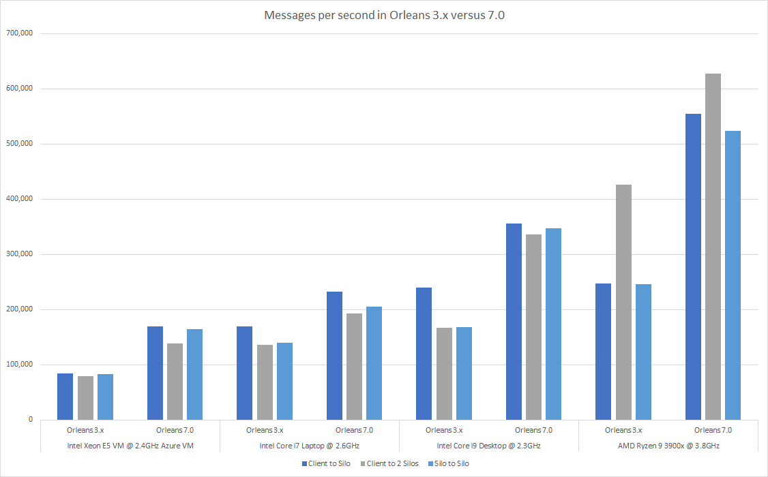
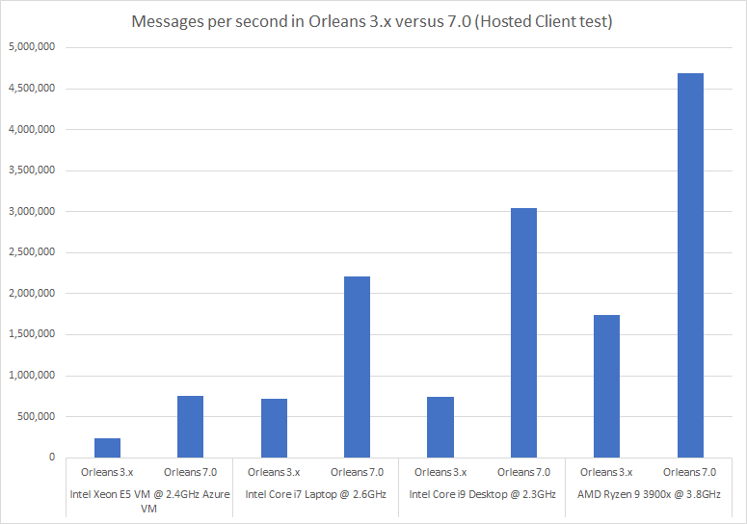
Orleans 7 has dramatic performance improvements
4x!
2x!
Silo-to-silo and client-to-silo(s) tests
Hosted client (in-process with the Silo) tests

Slide 12
Demo – Benjamin Petit
Simplified Grain and Stream identification in Orleans 7.0

Slide 13
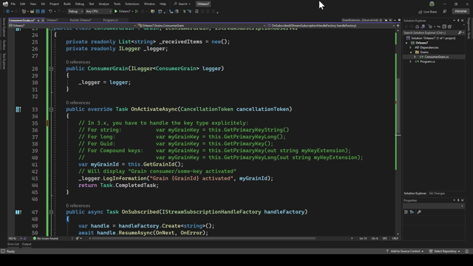

Slide 14
Demo – Reuben Bond
OpenTelemetry support in Orleans 7.0

Slide 15
Pillars of Observability for Cloud native apps
Logging
Distributed Tracing
Metrics

Slide 16
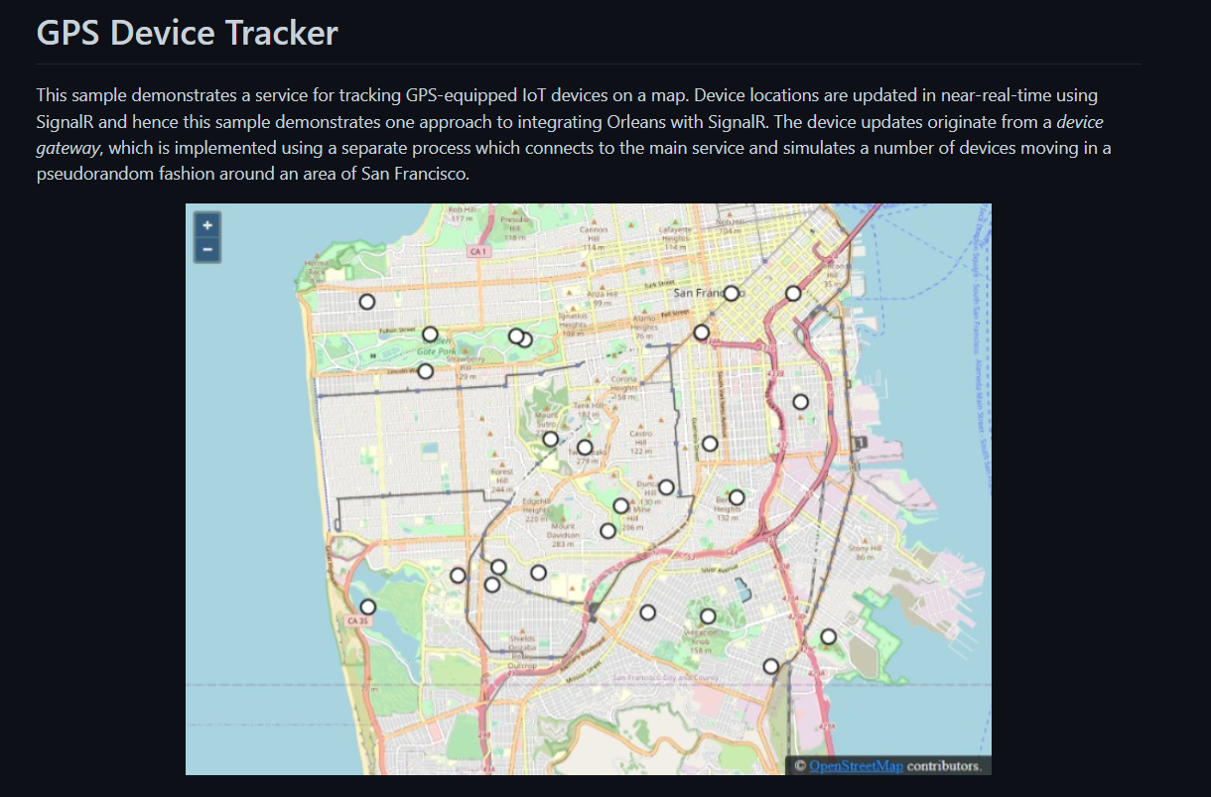

Slide 17
How metrics & traces are pumped from the app
GPSTracker Service
Prometheus
Grafana
Prometheus Endpoint
Prometheus scrapes metrics
Grafana uses Prometheus as a data source
Trace Monitoring
Zipkin
Jaeger
OpenTelemetry

Slide 18
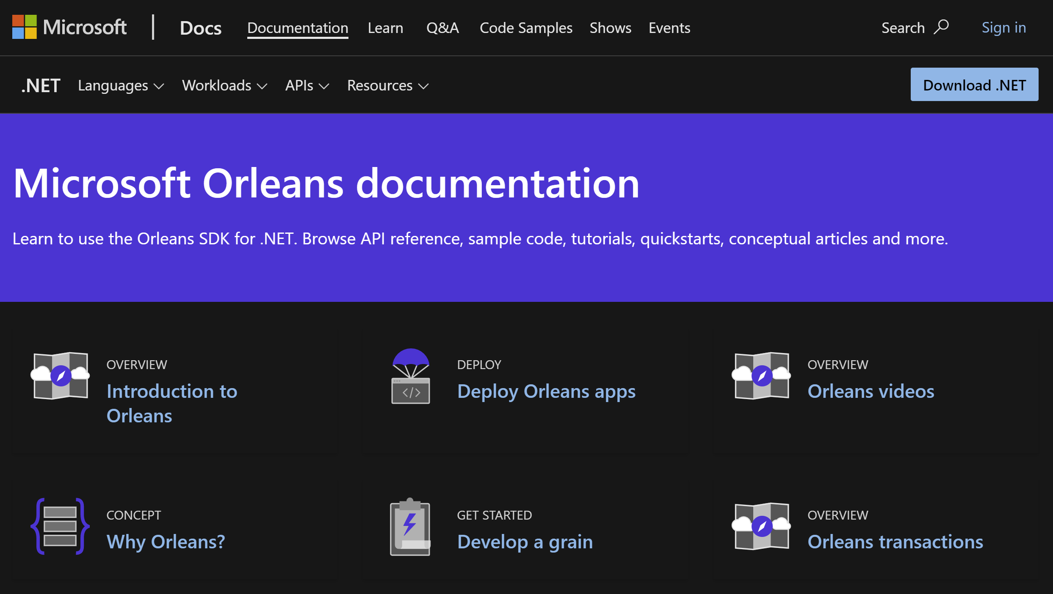
https://learn.microsoft.com/dotnet/orleans

Slide 19
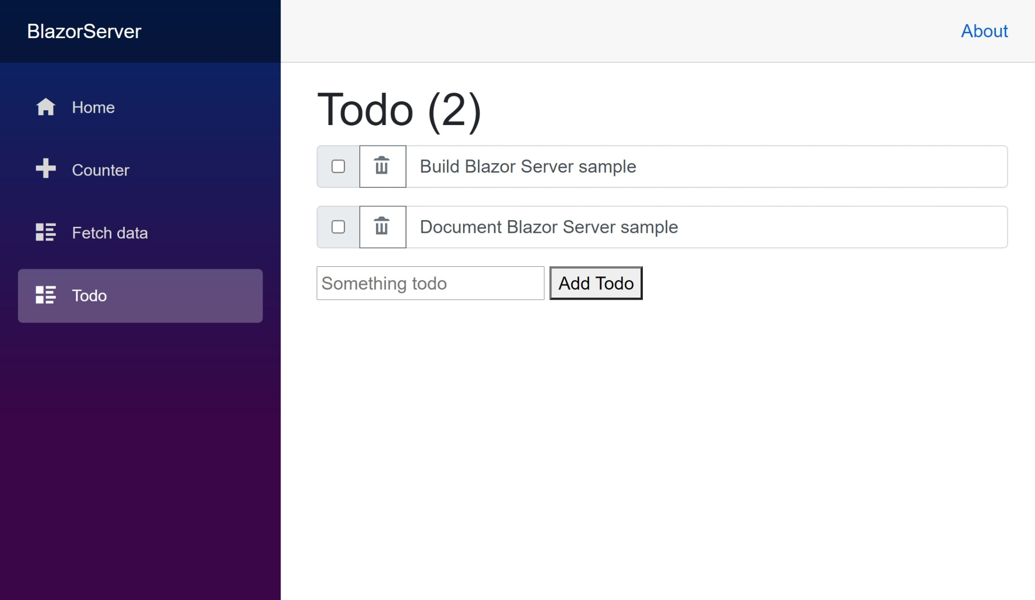
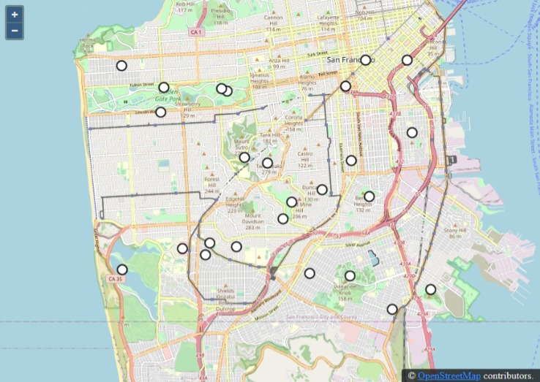
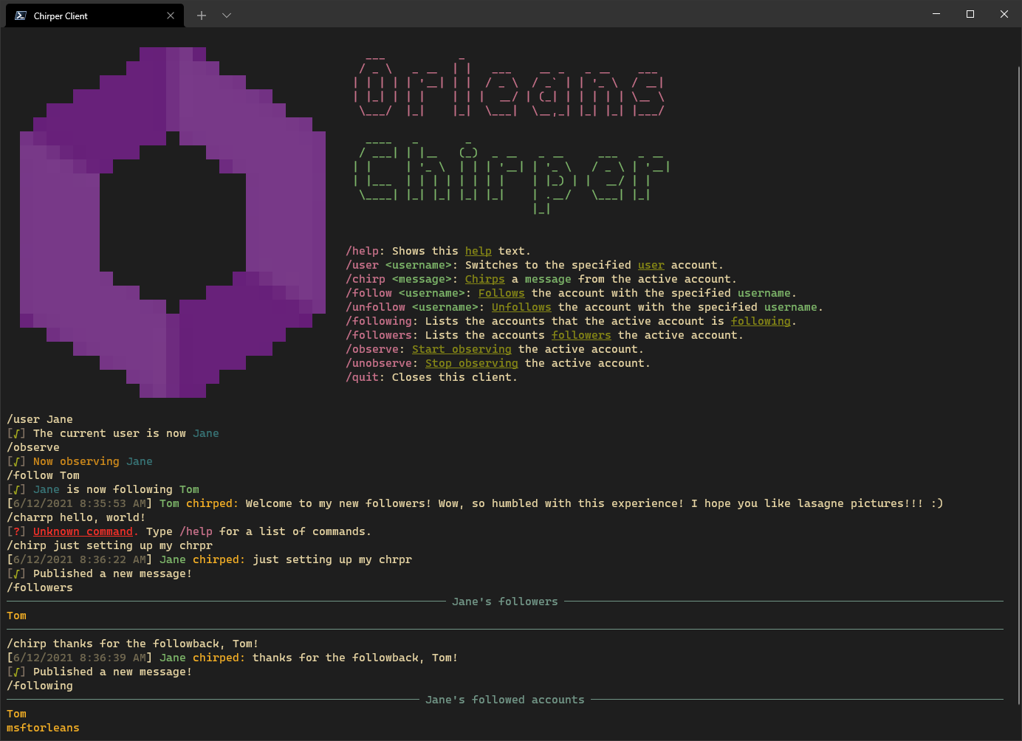
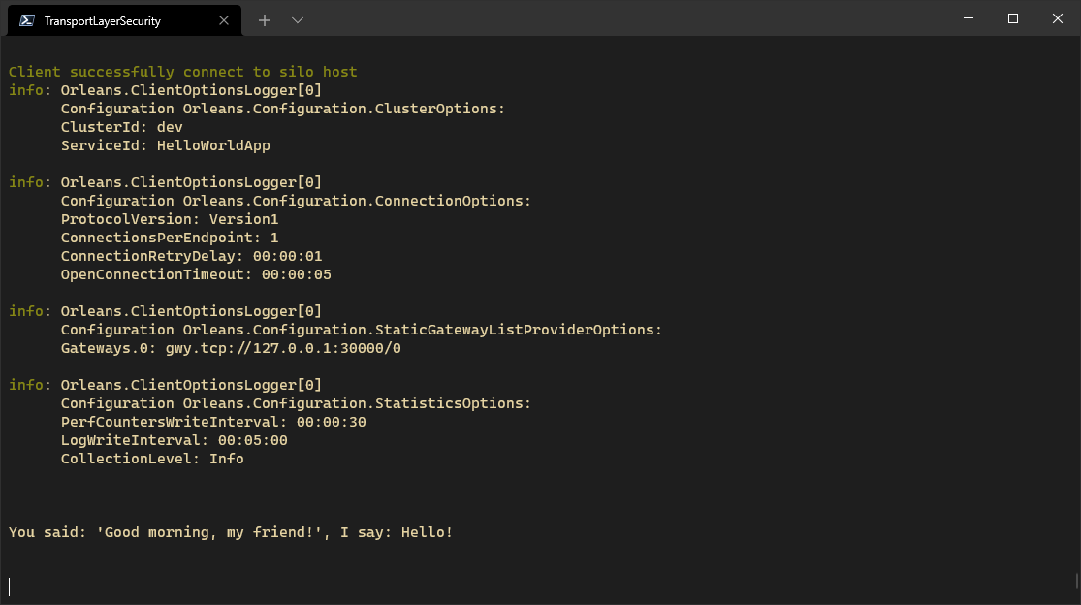
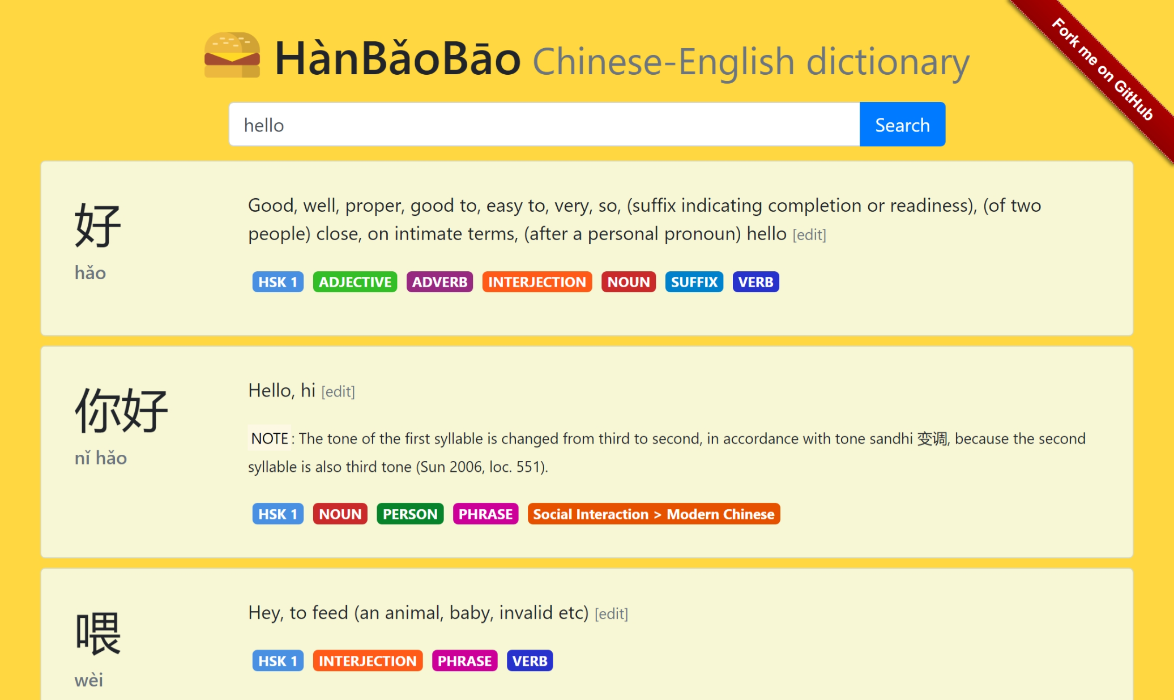
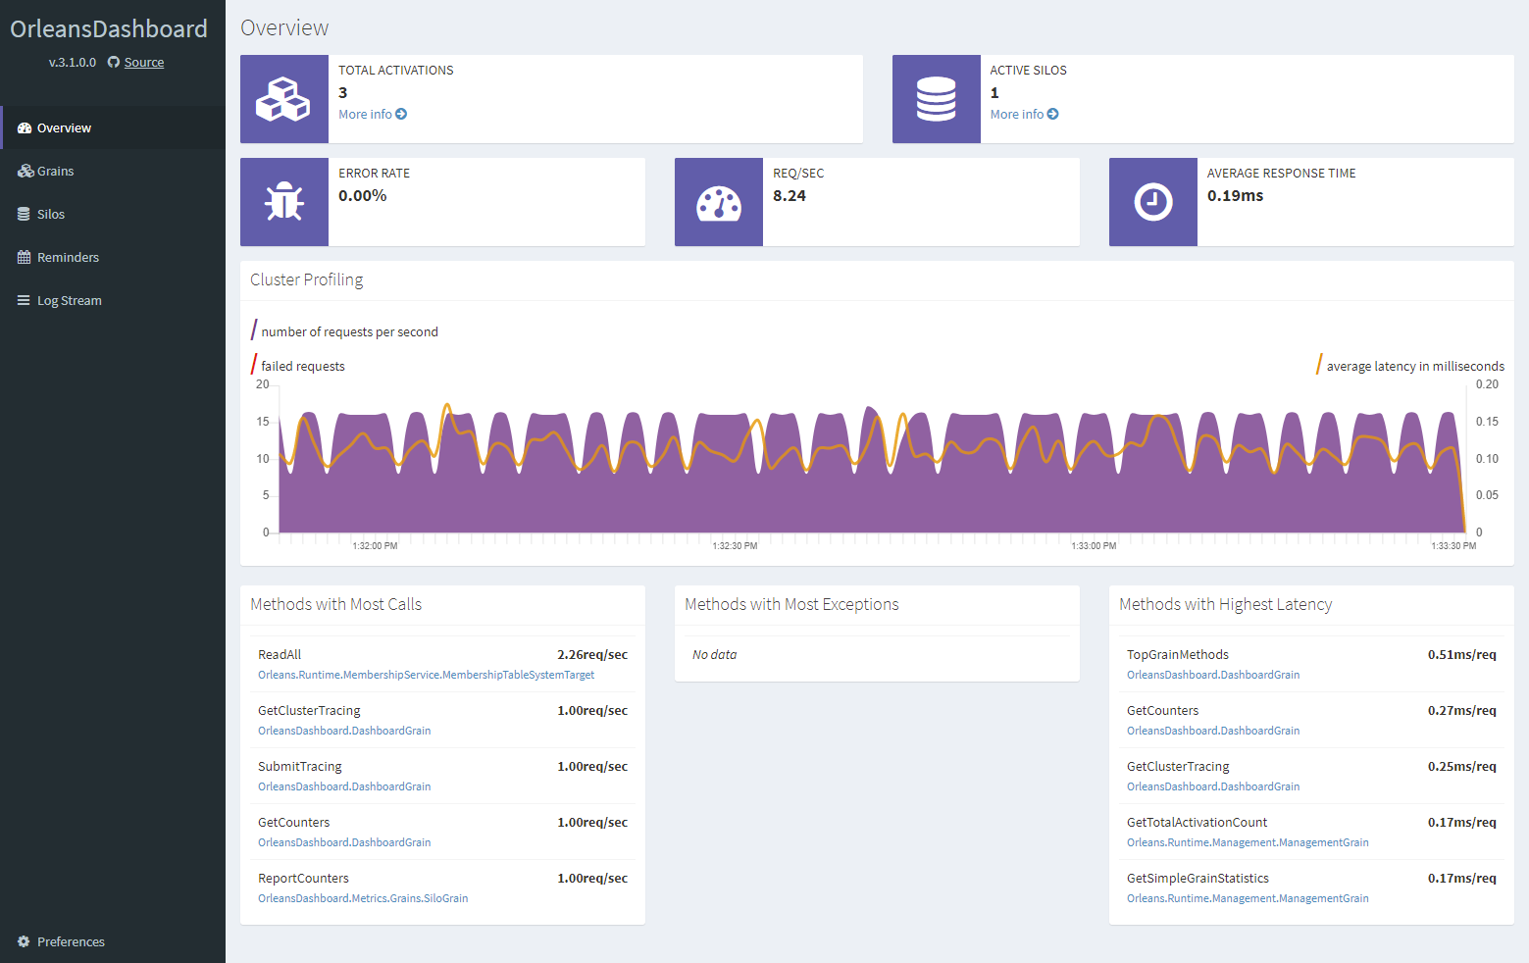
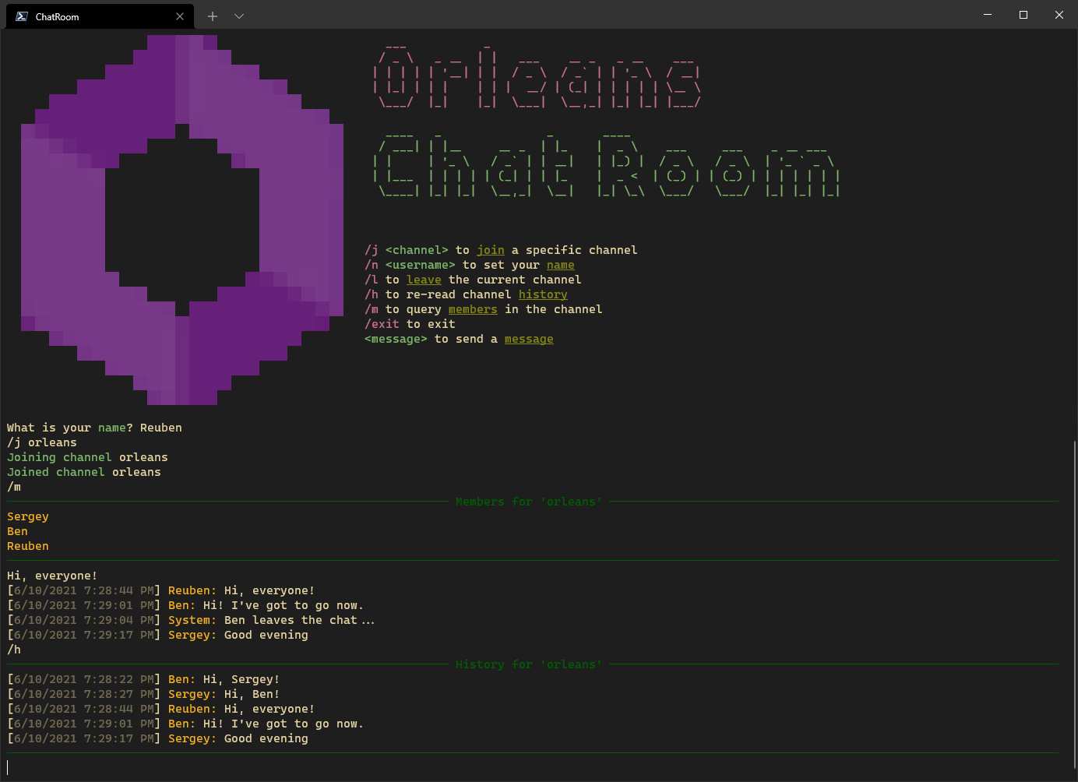
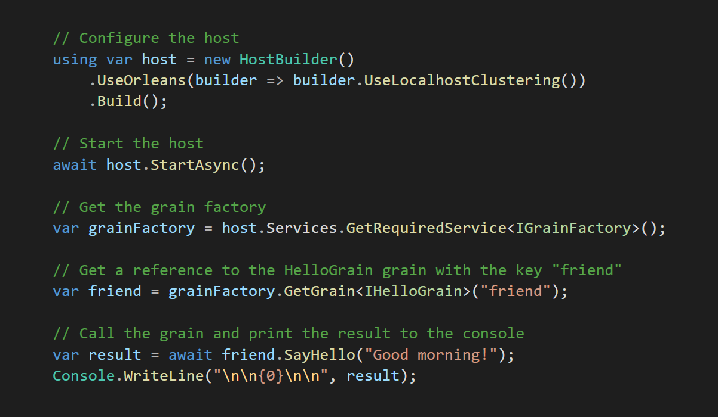
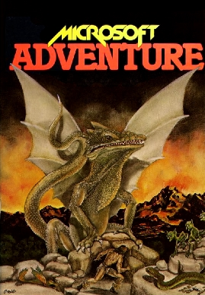
https://aka.ms/orleans/samples

Slide 20



github.com/dotnet/orleans
aka.ms/orleans/discord
@msftorleans
@bradygaster
@_benjaminpetit
@ReubenBond

